Slide 1
JavaTunes
By: Mohamed Elgharbawy,
Eugene Kim, Vyvy Tran

Slide 2
Outline
Project overview
Data set
Classes/UML Diagrams
Results
Project Demo

Slide 3

Overview
Similar to an iTunes, our media store sells both music and movies
We give the option to buy music, movies, and have a library of all purchased media.

Slide 4

Data Set
Uses the iTunes Search API to search for media
Example:
Search for “Location” by Khalid:
https://itunes.apple.com/search?term=Location&entity=song&limit=1
This returns a JSON (JavaScript Object Notation) file, which is parsed using a third party Json library
The data we chose to display was:
Song: Title, Artist, Length, Price
Movie: Title, Director, Length, Price

Slide 5
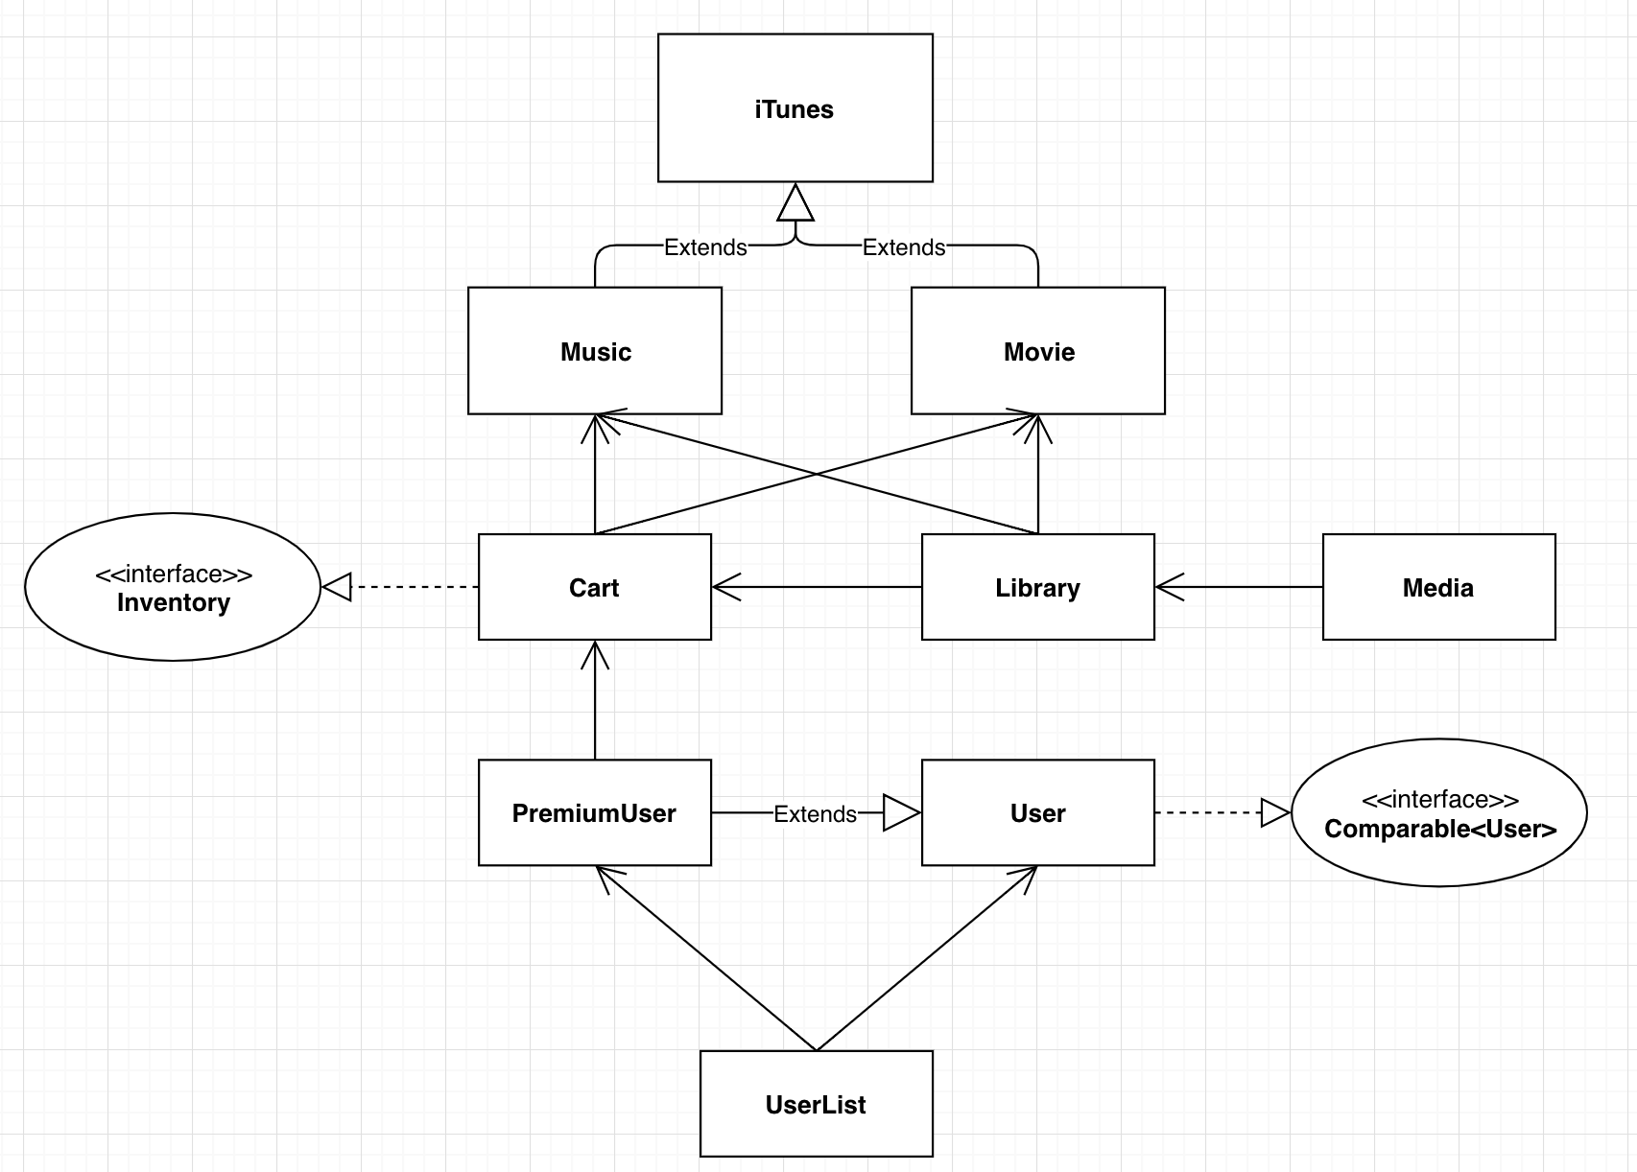
UML Overview

Slide 6
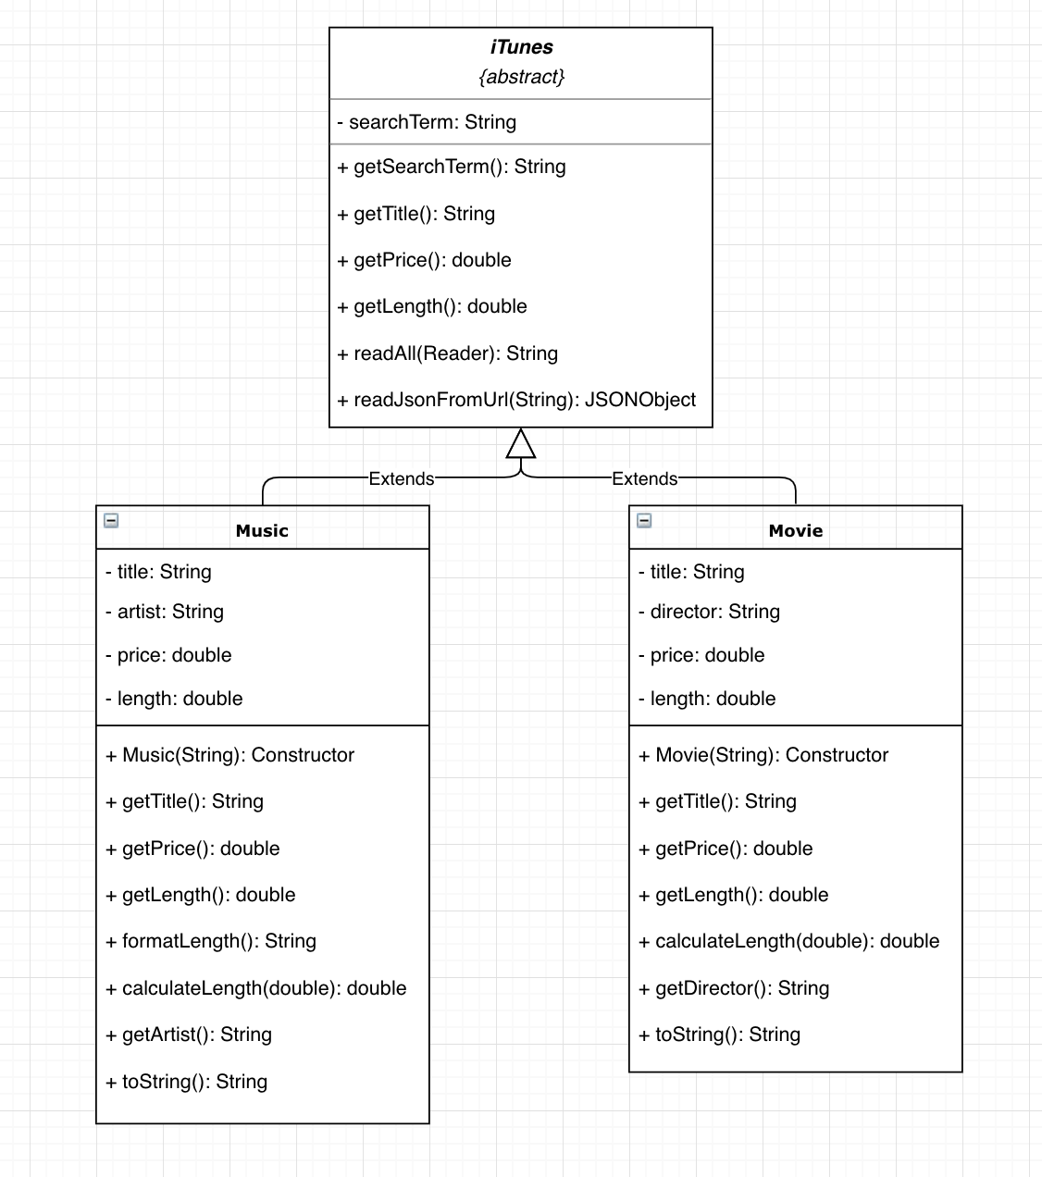
UML :
iTunes +
Music + Movie

Slide 7
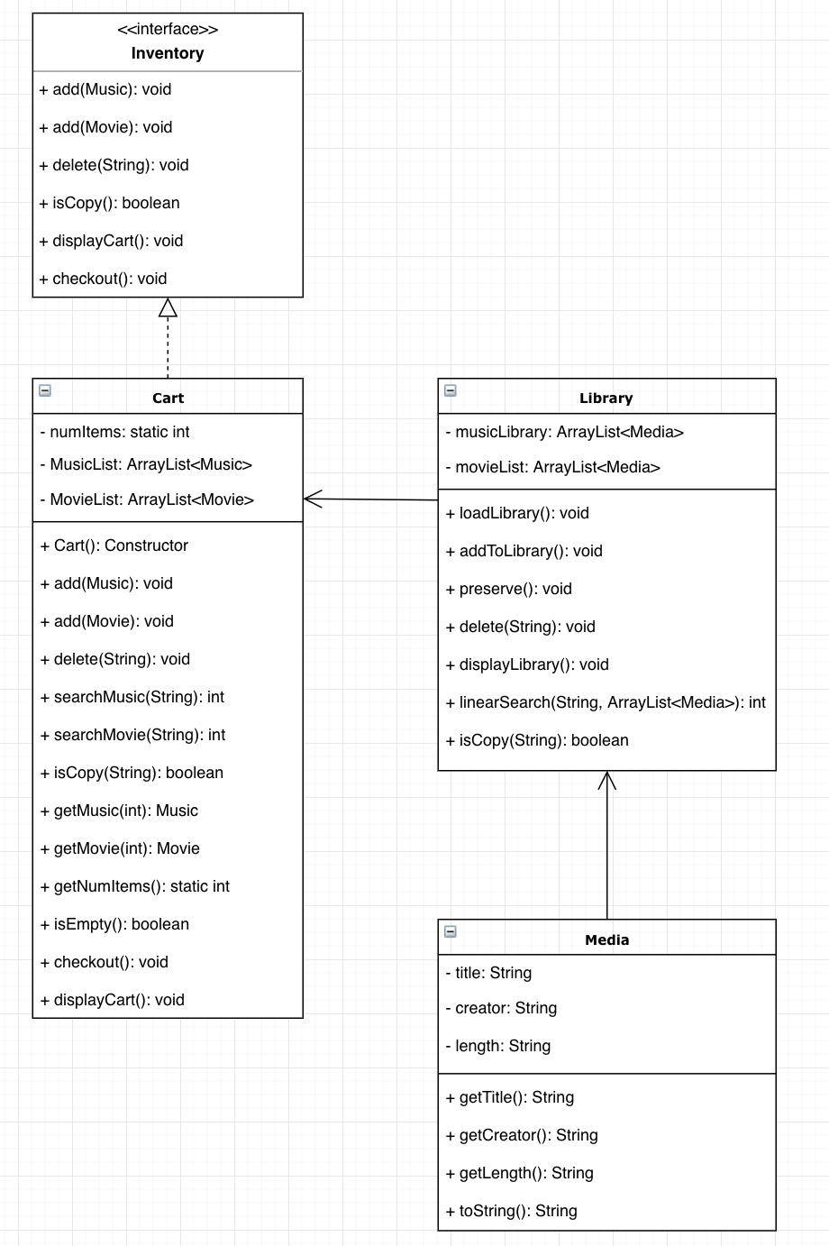
UML :
Inventory + Cart +
Library + Media

Slide 8
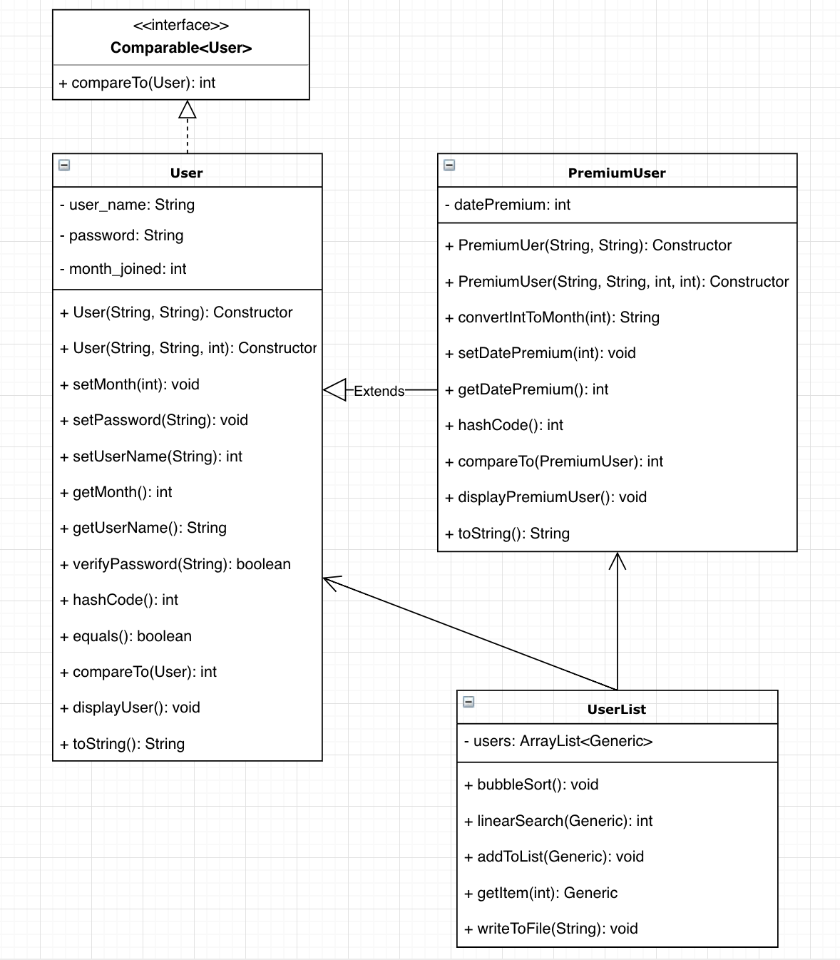
UML:
User + PremiumUser + UserList

Slide 9
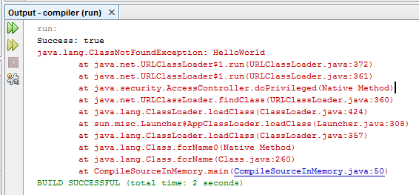
Results
Feedback
Let us view the account information
Remove items from cart
No duplicate media in Cart and Library
Errors
File I/O
Opening the file incorrectly
Writing over library.txt
Incorporating Generics into the program
Hard to sort/search generic objects
Couldn’t use generics with Music & Movie

Slide 10

Implemented Feedback
Added a remove option for cart
Added an option to view account information
Checked for duplicates in cart and library before adding an item to the cart

Slide 11
Live Demo

